Slide 1
MACOM Diode Products rev 7
Joe Bukowski, Rick Cory
1 August 2016

Slide 2
Diode Products Training
Week 1 - General MACOM diode overview
Week 2 - PIN Diode and Limiter theory/application/products.
Week 3 - Schottky Diode and Limiter theory, applications & products.
Week 4 - The HMIC process, including process overview, products, and performance benefits.
Week 5 - The AlGaAs process, including process overview, products, and performance benefits.
Week 6 - MACOM’s diode/switch product roadmaps
Week 7 - Comb Generators including theory, products in development, and application.

Slide 3
PRODUCT FAMILIES
PIN/NIP Diodes:
Switching
Attenuation
Limiting
Varactor Diodes:
Tuning
Phase Shifting
Schottky Diodes:
Detection
Frequency Mixing
Diode Products
Attenuators
Multiplier Diodes:
Frequency Multiplication
Waveshaping
Passive Devices
RF Chokes/Inductors
MNS Capacitors
Resistors

Slide 4
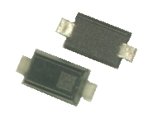





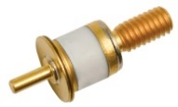




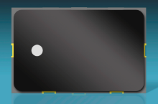
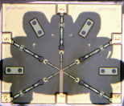
PRODUCT CONFIGURATIONS
Plastic
(to 6 GHz)
HMIC Discrete Surmount
(to 26.5GHz)
Bare Die
(to 18 GHz)
Discrete Device
MELF
(to 1 GHz)
Hermetic Packaged
(to 12 GHz)
Beam Lead/ Flip Chip
(to 70+ GHz)
HMIC, AlGaAs
(to 70+ GHz)
Integrated Solutions
Hybrid Solutions
Multichip Modules
(to 8 GHz)

Slide 5
DIODES & PASSIVE DEVICES
PIN/NIP Diodes:
Switching
Attenuation
Limiting
Varactor Diodes:
Tuning
Phase Shifting
Schottky Diodes:
Detection
Frequency Mixing
Diode Products
Attenuators
Multiplier Diodes:
Frequency Multiplication
Waveshaping
Passive Devices
RF Chokes/Inductors
MNS Capacitors
Resistors

Slide 6
PIN Diodes
Switching
Attenuation Receiver Protector Limiting

Slide 7
PIN Diodes
PIN Diodes are current-controlled RF resistors
Primarily used in control circuits
Switches
Attenuators
Limiters
MACOM PIN diodes can be made from Si, GaAs or AlGaAs

Slide 8
PIN Diodes
PIN Diodes used in switches typically have low capacitance and low series resistance
I layer thickness and thermal resistance determine RF power handling
PIN Diodes used in attenuators typically have
low capacitance for low insertion loss
thick I layers for large available range of resistance and low distortion
PIN Diodes used in limiters typically have low capacitance for low insertion loss
I layer thickness determines threshold level, recovery time and flat leakage

Slide 9
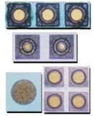
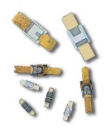

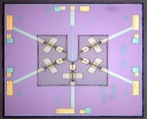
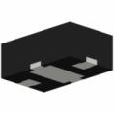
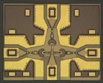

PIN Diode Families
Si Discrete | Si HMIC™ | GaAs | AlGaAs
Wide operating frequency range, to 20 GHz Excellent power handling PIN and NIP diodes available I layer: 2 – 300 µm Available as: Unpackaged chips SMT packages Ceramic Packages Beam leads | Very Wide operating frequency range, to 30 GHz I layer: 8 – 100 µm Available as Single junction devices Multiple junction ICs Wire-bondable or solderable | Wide operating frequency range, to 30 GHz Good power handling Available as: Unpackaged chips SMT packages Ceramic Packages Beam leads | Extremely Wide operating frequency range, to 100 GHz Lower insertion loss than comparable Si or GaAs switches I layer: 3 µm Available as Multiple junction ICs Wire-bondable

Slide 10




RF Power and Frequency Performance vs Diode Type
1k
3KV Ceramic
Die
Best Choice for Wire Bonding
100
AlN in 3mm, 4mm DFN
MELF
10
SURMOUNT
Best Choice for SMT
CW Incident Power (W)
1.0
SOD, SOT, Without AlN
0.1
Flip Chip, BL
F (GHz)
0.01
0.1
1.0
10
100

Slide 11


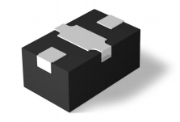
Si PIN DIODE SWITCH ELEMENT
Series, Shunt or Series-Shunt PIN Diodes
SMT Plastic Package
Medium Power Handling
Series PIN Diode Element
Series PIN Diode, Thermal-to-Ground Element
Shunt PIN Diode Element
Series-Shunt PIN Diode Element

Slide 12
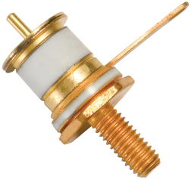

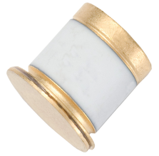
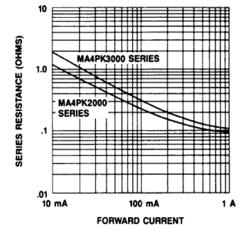
Discrete Kilovolt PIN Diodes
Features
High Voltage Handling:
Up to 2000 V, 3000 V
Power Handling: 1 kW
Operate from LF to 500 MHz
Long Carrier Lifetime: 30 µs, 65 µs
Very Low Thermal Resistance:
3 °C/W, 4 °C/W
Very Low Resistance: 0.1 Ω, 0.15 Ω
Applications
High Power and High Voltage Switching
Plasma Etching Systems
HF Radio Antenna Tuners

Slide 13
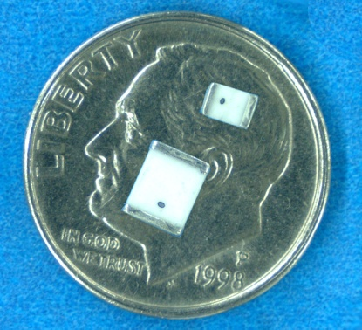
Discrete High Power MELF PIN Diodes
Features
High Voltage Handling: Up to 1100 V
200+ W Power Handling
Operate/Tunable from LF to 2.5 GHz
Surface Mountable
Non-Magnetic Versions
Superior Heat Management
Low Series Resistance
Applications
High Power Switches
Attenuators
Magnetic Resonance Imaging (MRI) Receiver Protection
#1 Supplier of MELF PIN Diodes
Available in Tape & Reel
Notes:
February 10, 2017

Slide 14
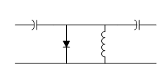
Discrete Diodes – Limiters
Limiter diodes can be thought of as RF-voltage-controlled variable attenuators
When input signal is small,
limiter diode impedance is high
RF signal is not attenuated
When RF signal is large,
it forces the diode’s impedance to be small
which reflects the input signal back to its source
No external control signal is required for the limiter to operate
DC current return path (RF choke) is required
Diode I layer thickness determines input power level at which the limiter “turns on”
Threshold level = input 1 dB compression point

Slide 15
Discrete Diodes – Limiters
Limiter diodes available
Die Versions (to 20 GHz)
Available in Ceramic & Plastic Packages (up to 12 GHz)
Low Capacitance
I layers from 2 µm to 40 µm
Cascadable for Increased Power Handling and Limiting
Thinnest diode placed at output stage
Determines threshold level, spike leakage
Thickest diode placed at input stage
Determines power handling, recovery time
I standing wave
V standing wave
Thick “coarse” limiter
λ/4
Thin “clean-up” limiter

Slide 16
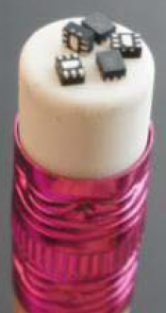
Discrete Limiter Products
Broadband Performance to 12 GHz and Higher
Several Packages Available Including
Low Inductance Shunt Configuration Plastic 1.5 X 1.2 mm DFN
Ceramic
Chips
Cascadable
Schottky-Limiter-PIN Shunt Antiparallel Pair
Shunt Limiter PIN
Limiter PIN

Slide 17
PIN Switches
Modules Single-Chip

Slide 18
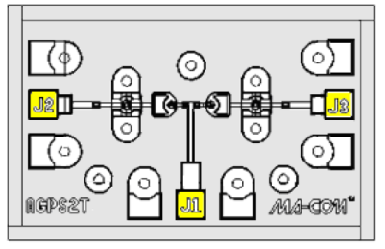
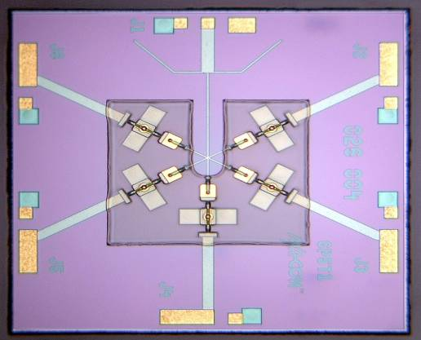
AlGaAs PIN Diode Switches
Product Offering
SPST to SP8T
Features
Operating Frequency = 50 MHz - 70 GHz
Maximum RF Average Incident Power = 0.25 W CW
AlGaAs ~ 0.3 dB Lower IL (20 GHz) vs. GaAs & Si Switches
Very Low Insertion Loss
Excellent Isolation
Low Switching Time
SP2T
SP5T
SPST

Slide 19
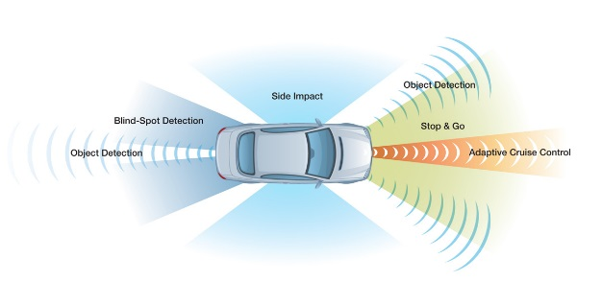
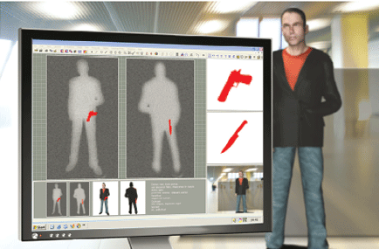
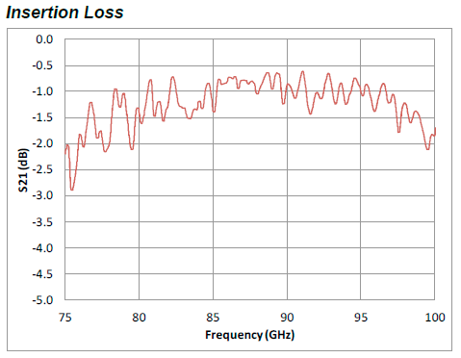
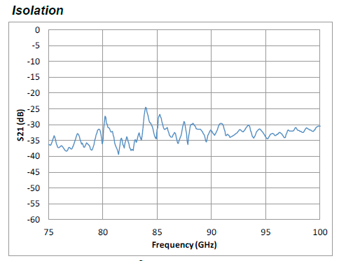
AlGaAs SP3T W Band Switch MASW-011029
Broadband Operating Frequency: 60 - 110 GHz
Insertion Loss:1.3 dB Typical
Isolation: 33 dB Typical
Silicon Nitride Passivation
BCB Scratch Protection
Collision Avoidance Radar
Passive Imaging

Slide 20

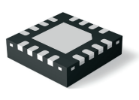
Multichip Module High Power Switches
Input power handling to 200 W CW, 1 kW peak
Frequency Range: 20 MHz – 6 GHz in three bands
Symmetric and Asymmetric Designs
SP2T, SP3T, SP4T, SP6T

Slide 21
T/R Switch-Limiter Module MSWLM2420-242
Features
Frequency Range: 2 – 4 GHz
T/R switch with passive receiver protection detector/limiter
Excellent Rx path insertion loss with 2 W CW receiver protector limiter stage
TX input power: 125 W CW, 200 W pk
Packaged in 5 x 8 mm, low-thermal-resistance surface-mount module package
Proven performance in the field
Applications
Phased array radar T/R modules
Radio transceiver

Slide 22
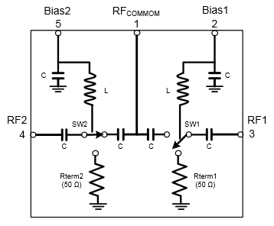
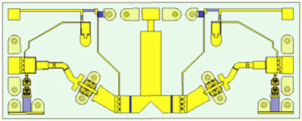
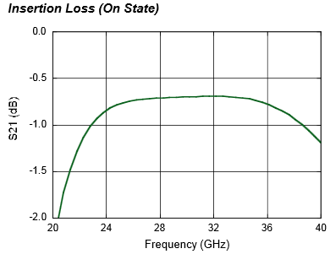
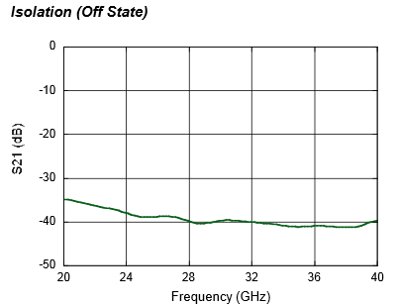
MASW-011036 Ka-Band High Power Terminated AlGaAs SPDT PIN Switch
Broadband Performance: 26 to 40 GHz
Low Loss <1 dB; High Isolation >38 dB
Up to 13 W CW Power, 85 °C
Die with G-S-G RF Pads and DC Bias Pads
Includes DC Blocks and RF Bias Networks
23 dBm power handling in terminated port
Notes:
Delete specs table?

Slide 23
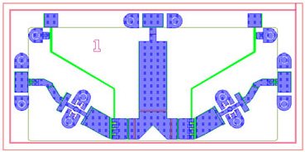
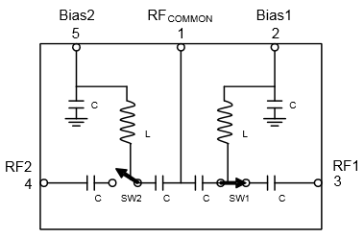
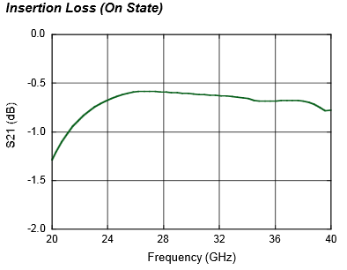
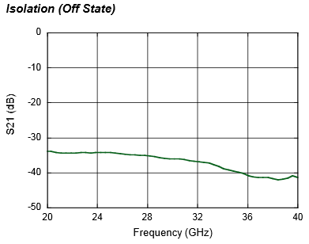
MASW-010646 Ka-Band High Power Reflective AlGaAs SPDT PIN Switch
Broadband Performance: 26 to 40 GHz
Low Loss: 0.6 dB
High Isolation: 32 dB
Up to 13 W CW Power, 85 °C
Die with G-S-G RF Pads and DC Bias Pads
Includes DC Blocks and RF Bias Networks
Notes:
Delete specs table?

Slide 24
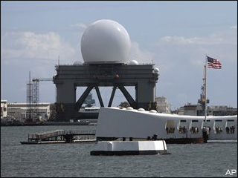
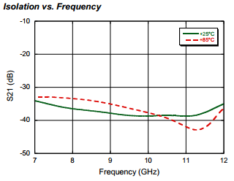
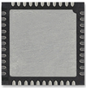
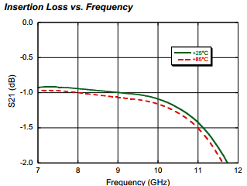
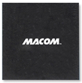
X-Band Terminated SPDT Switch MASW-011071
Low Insertion Loss: 1 dB
High Isolation: 38 dB
Integrated Bias Network and Termination Circuit
Greater than 20 W CW Power Handling @ 70 °C
Lead (Pb)-Free 7 x 7 mm 44-lead PQFN Package
Missile Defense, Weather Radar Systems

Slide 25
HMIC™ Si PIN Switches: 2 W, DC – 26 GHz
Products
MASW-001100-11900W (SPST)
MASW002100-11910W (SPDT)
MASW-003100-19220W (SP3T)
MASW-004100-11930W (SP4T)
MASW-005100-11940W (SP5T)
Features
Operating Frequency
50 MHz – 30 GHz
Series-Shunt Configuration
High Isolation: >35 dB
Low Loss: <1.0 dB Insertion Loss
Switching Time: 50 ns
Max RF Incident Power:
>6.0 W CW @ 2 GHz
2.0 W CW @ 22 GHz
RoHS Compliant
SP5T
SP3T w/ Integrated Bias Network
Notes:
25

Slide 26
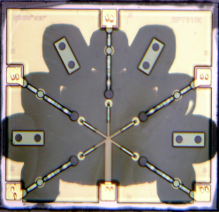
HMICTM Wire-Bondable Switches
Features
SPST through SP6T
Broadband Performance to 26 GHz
Wire /Ribbon Bond Connections
Available With or Without Integrated Bias Networks
SP3T with Bias Network
SP5T without Bias Network

Slide 27
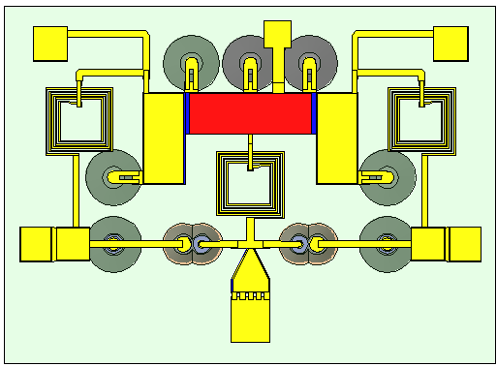
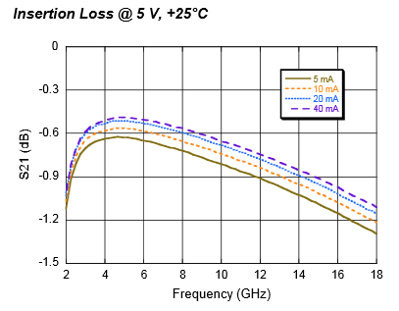
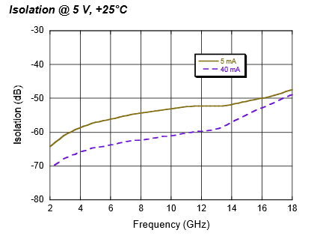
HMICTM SP2T High Current MASW-011052
Broad Bandwidth: Specified up to 18 GHz, Usable up to 26 GHz
Integrated Bias Network: High Bias Current +/- 60 mA
Low Insertion Loss/High Isolation
Glass Encapsulation Construction
RoHS Compliant and 260 °C Reflow Compatible

Slide 28
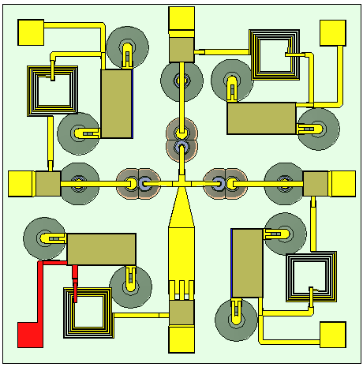
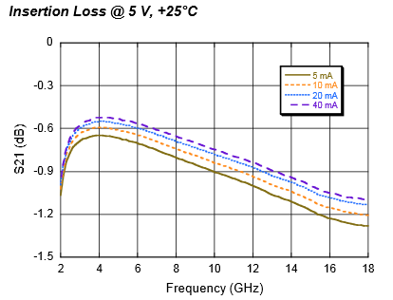
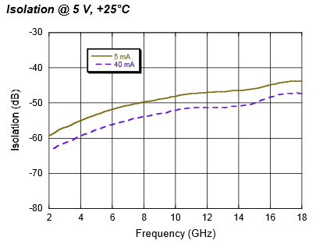
HMICTM SP3T High Current MASW-011053
Broad Bandwidth: Specified up to 18 GHz, Usable up to 26 GHz
Integrated Bias Network: High Bias Current +/- 60 mA
Low Insertion Loss/High Isolation
Glass Encapsulation Construction
RoHS Compliant and 260 °C Reflow Compatible

Slide 29
Limiter Modules

Slide 30
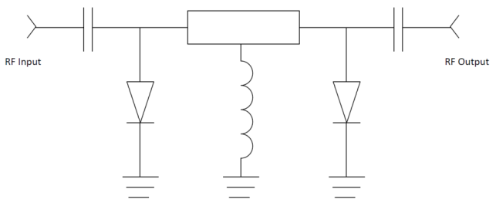

High Power Limiter Modules
Industry-leading input power handling as high as
300 W CW
2 kW peak
No external control signal or bias required
Available as
Single stage
Dual stage
Detector/limiter
Available in VHF, UHF, L, S and C bands
Packaged in low-thermal-resistance surface-mount hermetic or nonhermetic module packages

Slide 31
Tuning Varactor Diodes
VCO Phase Shifter

Slide 32
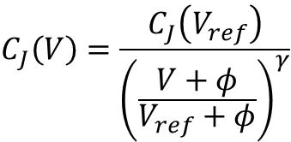

Tuning Varactor
Tuning varactors are PN junction diodes which act as voltage-controlled variable capacitors
The depletion region at the junction acts as the dielectric layer of a parallel plate capacitor
Physically separates the P and the N layers, which act as the plates
Reverse bias voltage magnitude controls the thickness of the dielectric layer, which controls the capacitance of the varactor
p
+++++++++++++++++++++++++++++
-
V
depletion region
d
+
n
- - - - - - - - - -
$$C_{J}=\frac{εA}{d}$$
$$C_{J}\left(V\right)=\frac{C_{J}\left(V_{ref}\right)}{{\left(\frac{V+φ}{V_{ref}+φ}\right)}^{γ}}$$

Slide 33
Tuning Varactor Diodes
Si, GaAs Abrupt
GaAs γ=0.75
GaAs γ=1.0
GaAs γ=1.25
Si Hyperabrupt
GaAs γ=1.5
Large Variety of silicon (Si) and gallium arsenide (GaAs) tuning varactors
Available as chips and in a wide variety of packages
Si
Abrupt junction
Hyperabrupt junction
GaAs
Abrupt junction
Constant Gamma hyperabrupt junction

Slide 34
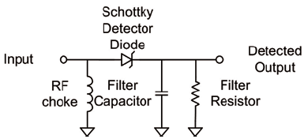
Schottky Diodes
Si and GaAs Frequency Mixing Detection

Slide 35
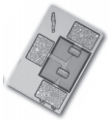


GaAs Flip Chip Schottky Diodes
Features
Available As:
Single Junction
Series Tees
Reverse Series Tees
Antiparallel Pairs
Unconnected Pairs
Low Series Resistance
Low Junction Capacitance
Applications
Mixer and Detector Applications

Slide 36
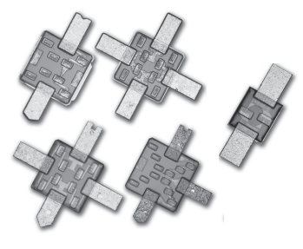

GaAs Beamlead Schottky Diodes
Features
Single Barrier Height
Frequency Range: DC – 40 GHz
Available as
Single Junction
2-, 4- and 6-Junction Series Tees
Antiparallel Pairs
4-, 8- and 12-Junction Ring Quad
Low Series Resistance
Low Junction Capacitance
Applications
Mixer and Detector Applications

Slide 37
HMICTM Discrete Schottky Diodes
Features
Surmount Single-Junction Si Schottky diodes
Low, Medium and High Barrier Heights Available
Frequency Range: DC – 30 GHz
Very Low Series Resistance
Very Low Junction Capacitance
Solderable – No Wire Bonds Required
Applications
Mixers and Detectors
Receiver Protector Limiters

Slide 38
Flip Chip Diodes
PIN
Schottky
Varactor

Slide 39
Solderable Flip Chip Devices
Ultra Low Capacitance
Millimeter Wave Switching & Cutoff Frequency
Silicon Nitride Passivation
Polyimide Scratch Protection
Cu/Ni/Au Solderable Terminals
RoHS Compliant
PIN Diode - Switching
Parameter | Units | MADP-000907-1402
Frequency | GHz | Up to 30 GHz
Capacitance @ 10 V | pF | 0.025 pF Typical
Series Resistance | - | 7 Ω max
Breakdown Voltage | V | 50 V min
Size | mm | 0.67 X 0.35 mm
Varactor Diode – VCO/Phase Shifter
Parameter | Units | MAVR-000120-1141
Frequency | GHz | Up to 30 GHz
Capacitance @ 0 V | pF | 1.1 pF Typical
Capacitance @ 4 V | pF | 0.30-0.40 pF
Capacitance @ 10 V | pF | 0.14-0.20 pF
Gamma 2-12 V | - | 0.9-1.1
Q | - | 3000 min
Breakdown Voltage | V | 20 V min
Size | mm | 0.75 X 0.40 mm
Schottky Diode – Mixer/Detector
Parameter | Units | MADS-01317-1500
Frequency | GHz | Up to 80 GHz
Capacitance @ 10 V | pF | 0.045 pF Typical
Series Resistance | - | 4 Ω Typical
Breakdown Voltage | V | 4.5 V min
Size | mm | 0.75 X 0.40 mm

Slide 40
Passive Devices
HMIC™ Bias Networks
Attenuators
MNS Capacitors Spiral Inductors Resistor Networks

Slide 41
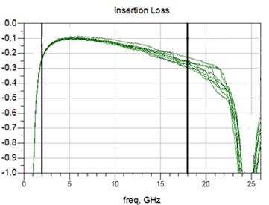
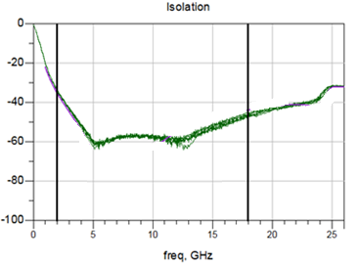


MABT-011000 2-18 GHz HMICTM Surmount Bias Network
HMIC™ Surmount Technology
Broadband Performance 2 – 18 GHz
Parameter | Frequency (GHz) | Target Min | Target Avg | Target Max
Insertion Loss | 2 | - | 0.1 | 0.50
 | 6
 | 12
 | 18
RF – DC Isolation | 2 | 30 | 35 | -
 | 6
 | 12
 | 18
Input Return Loss | 2 | 15 | 17 | -
 | 6
 | 12
 | 18
Output Return Loss | 2 | 15 | 17 | -
 | 6
 | 12
 | 18
High current ±60mA; Voltage ±50V

Slide 42
Thin Film Passive Products: Capacitors
Products:
Single Capacitors
Binary Capacitor Networks
C = 1 – 500 pF
Features:
Si₃N₄ & Si0₂ Capacitor Dielectrics provide Proven Reliability, Stability and Good Q >30 @ 2 GHz
Compact Size < 100 mil sq.
Applications:
Bias networks
Filters from DC - 40 GHz

Slide 43

Thin Film Passive Products: Inductors
Products:
Surface Mount Inductors,
L = 5 - 300 nH
Features:
Surface Mount Spiral Inductors on Quartz Substrates
Q > 50 @ 1 GHz.
Applications:
Bias networks

Slide 44



Thin Film Passive Products: Resistors & Attenuators
Products:
DC – 20 GHz Attenuator Products.
α = 1 - 30 dB in 1 dB steps
Surface Mount Resistors & Resistor Networks
R = 1 Ω – 100 kΩ
Features:
TCR of TaN Thin Film Resistors < 100 ppm/º C.
TCR of NiCr Thin Film Resistors < 10 ppm/ºC.
Applications:
RF Power Management
Bias networks

Slide 45
Thank You

Slide 46
Appendix

Slide 47


Discrete Diodes – Si PIN Chips
High Voltage Handling: up to 1000 V
Power Handling: 200+ Watts
Operate from LF to 18 GHz
Chip and Wire Assembly
Low Series Resistance
Applications: Switching and Attenuating
Part Number | Breakdown Voltage (V) | Capacitance (pF) | Series Resistance (Ω) | Carrier Lifetime (μs) | Thermal Resistance (ºC/W) | I-region (μm)
MADP-000165-01340W | 200 | 0.06 | 2.50 | 0.20 | 150 | 19
MA4P161-134 | 100 | 0.10 | 1.50 | 0.150 | 65 | 13
MA47416-132 | 200 | 0.15 | 6.00 | 2.00 | 30.0 | 110
MA47418-134 | 200 | 0.15 | 3.00 | 1.00 | 25.0 | 48
MA4P203-134 | 100 | 0.15 | 1.50 | 0.150 | 75.0 | 13
MA4P303-134 | 200 | 0.15 | 1.50 | 0.20 | 85 | 19
MA4P404-132 | 250 | 0.20 | 0.70 | 0.60 | 30.0 | 28
MA4P504-132 | 500 | 0.20 | 0.60 | 1.00 | 35.0 | 44
MA4P604-131 | 1000 | 0.30 | 1.00 | 3.00 | 10.0 | 96
MA4P505-131 | 500 | 0.35 | 0.45 | 2.00 | 14.0 | 96
MA4P606-131 | 1000 | 0.60 | 0.70 | 4.00 | 8.0 | 96
MA4P506-131 | 500 | 0.70 | 0.30 | 3.00 | 11.0 | 51
MA4P607-212 | 1000 | 1.30 | 0.40 | 5.00 | 4.0 | 125
Notes:
February 10, 2017

Slide 48

Discrete Diodes – Si NIP Chips
High Voltage Handling: up to 500 V
Power Handling: 50+ Watts
Operate from LF to 12+ GHz
Chip and Wire Assembly or Available in Packages
Low Series Resistance
Applications: Switching and Attenuating
Notes:
February 10, 2017

Slide 49

Si Mesa Beamlead PIN Diodes
Rugged Silicon-Glass Construction
Silicon Nitride Passivation
Low Parasitic Capacitance and Inductance

Slide 50
Si Planar Beamlead PIN Diodes
Rugged Silicon-Glass Construction
Silicon Nitride Passivation
Low Parasitic Capacitance and Inductance

Slide 51

Flip Chip Products
Low Capacitance Devices
PIN Diodes | Configuration | Max Frequency | Breakdown Voltage Vb | Ct Max | Rs Typical | Material
 |  | (GHz) | (V) | (pf) | (Ω)
MA4GP907 | Single | 40 | 45 | 0.025 | 4.2 | GaAs
MA4AGP907 | Single | 50 | 50 | 0.020 | 4.2 | AlGaAs
MA4FCP200 | Single | 40 | 50 | 0.015 | 2.8 | HMIC
MA4FCP300 | Single | 30 | 70 | 0.025 | 2.6 | HMIC
MA4FCP305 | Single | 18 | 40 | 0.050 | 2.1 | HMIC
Varactor Diodes | Configuration | Max Frequency | Breakdown Voltage Vb | Ct 4V | Gamma | Material
 |  | (GHz) | (V) | (pf)
MA46H146 | Single | 60 | 26 | 0.033-0.06 | 1 | GaAs
MA46H120 | Single | 60 | 15 | 0.20-0.40 | 0.5 | GaAs

Slide 52

Discrete High Power MELF PIN Diodes
Part Number | Breakdown Voltage | Total Capacitance | Series Resistance | Carrier Lifetime | Thermal Resistance Θ
 | (V) | (pF) | (Ω) | (μs) | (ºC/W)
MA4P504-1072T | 500 | 0.5 | 0.6 | 1.0 | 15
MA4PH236-1072T | 200 | 0.5 | 3.00 | 1.5 | 25
MA4PH238-1072T | 200 | 0.5 | 6.00 | 2.0 | 25
MA4P404-1072T | 250 | 0.6 | 0.60 | 0.6 | 10
MA4P505-1072T | 500 | 0.7 | 0.45 | 2.0 | 6
MA4P7006F-1072T | 600 | 0.7 | 0.90 | 3.0 | 50
MA4P7417-1072T | 800 | 0.7 | 0.80 | 6.5 | 13
MA4P7104F-1072T | 400 | 1.0 | 0.50 | 2.5 | 50
MA4P506-1072T | 500 | 1.0 | 0.30 | 3.0 | 10
MA4P1250-1072T | 50 | 1.2 | 0.75 | 2.0 | 15
MA4PH235-1072T | 35 | 1.2 | 0.50 | 0.3 | 20
MADP-000234-10720T | 500 | 1.7 | 0.25 | 1.5 | 30
MA4P4301F-1091T | 100 | 2.0 | 1.00 | 8.0 | 30
MA4P4306F-1091T | 600 | 2.0 | 1.00 | 8.0 | 30
MA4P4006F-1091T | 600 | 2.2 | 0.50 | 6.0 | 20
MA4P1450-1091T | 50 | 2.5 | 0.75 | 2.0 | 5
MA4P7418-1072T | 1100 | 0.8 | 1.20 | 5.0 | 13
High Voltage Handling: Up to 1100 V
200+ W Power Handling
Operate/Tunable from DC to 2.5 GHz
Surface Mountable
Non-Magnetic Versions
Superior Heat Management
Low Series Resistance
Applications
High Power Switches
Attenuators
Magnetic Resonance Imaging (MRI)
Non Magnetic Package | MA4P7441F-1091T | 100 | 2.2 | 0.50 | 18 | 5
 | MA4P7446F-1091T | 600 | 2.2 | 0.50 | 18 | 6
 | MA4P7452F-1072T | 150 | 0.7 | 0.90 | 9 | 15
 | MA4P7461F-1072T | 100 | 1.0 | 0.50 | 6 | 15
 | MA4P7464F-1072T | 400 | 0.8 | 0.60 | 4.5 | 20
 | MA4P7470F-1072T | 800 | 0.7 | 0.80 | 6.5 | 13
 | MADP-000235-10720T | 35 | 1.2 | 0.50 | 0.3 | 20
Available in Tape & Reel
#1 Supplier of MELF PIN DIODES
Notes:
February 10, 2017

Slide 53
PIN DIODE SWITCH ELEMENT
Part Number | Rated Power Max (W) | Frequency Maximum (GHz) | Insertion Loss Typical |  |  | Isolation Typical |  |  | Package
 |  |  | Frequency (GHz) |  |  | Frequency (GHz)
 |  |  | 1 | 2.5 | 6 | 1 | 2.5 | 6
MSWSE-005-10S | 5 | 6 | 0.15 | 0.2 | 0.25 | 26 | 17 | 10 | 402
MSWSE-005-15 | 4 | 6 | 0.2 | 0.25 | 0.45 | 24 | 17 | 10 | 503
MSWSE-010-15 | 10 | 2.5 | 0.25 | 0.25 | – | 18 | 9 | – | 503
MSWSE-010-15S | 10 | 3 | 0.05 | 0.25 | – | 20 | 15 | – | 0402P
MSWSE-010-16S | 10 | 3 | 0.06 | 0.08 | – | 20 | 14 | – | 0402P
MSWSE-020-05 | 20 | 1 | 0.05 | – | – | 8 | – | – | 503
MADP-010630-13920T | 25 | 3 | 0.15 | 0.35 | - | 17 | 9 | - | 0805
MSWSE-020-10 | 20 | 1 | 0.03 | – | – | 18 | – | – | 503
MADP-010631-13920T | 40 | 1 | 0.05 | 0.08 | - | 7 | - | - | 0805
MSWSE-040-10 | 40 | 3 | 0.1 | 0.2 | – | 20 | 12 | – | 0805P
MSWSE-044-10 | 40 | 2 | 0.15 | 0.3 | – | 15 | 8 | – | 0805P
MSWSE-050-10 | 50 | 1 | 0.1 | – | – | 10 | – | – | 0805P
MADP-010633-13920T | >50 | 3 | 0.15 | 0.30 | - | 15 | 7 | - | 0805
MSWSE-050-17 | 40 | 3 | 0.06 | 0.1 | – | 18 | 11 | – | 0805P
MSWSER-070-10 | 80 | 0.8 | 0.06 | – | – | 10 | – | – | 3023
MSWSER-100-05 | 80 | 0.8 | 0.15 | – | – | 10 | – | – | 3023
Discrete Series PIN Diode
Plastic Package
Medium Power Handling
Part Number | Rated Power Max (W) | Frequency Maximum (GHz) | Insertion Loss Typical |  |  | Isolation Typical |  |  | Package*
 |  |  | Frequency (GHz) |  |  | Frequency (GHz)
 |  |  | 1 | 2.5 | 6 | 1 | 2.5 | 6
MEST2G-010-20 | 10 | 10 | 0.3 | 0.3 | 0.45 | 31 | 23 | 18 | 2012
MEST2G-020-15 | 20 | 6 | 0.2 | 0.22 | 0.3 | 25 | 20 | 11 | 2012
MEST2G-050-45 | 50 | 2.5 | 0.15 | 0.15 | – | 16 | 10 | – | 2615
MEST2G-050-80 | 50 | 1.5 | 0.15 | 0.2 | – | 14 | 8 | – | 2615
MEST2G-010-20 | 10 | 10 | 0.3 | 0.3 | 0.45 | 31 | 23 | 18 | 2012

Slide 54



PIN DIODE SWITCH ELEMENT
Die mounted on thermally-conductive, electrically-insulating substrate
Very low thermal resistance for high-power handling
Part Number | Rated CW Power Max (W) | Frequency Maximum (GHz) | Insertion Loss Typical |  |  | Isolation Typical |  |  | Package*
 |  |  | Frequency (GHz) |  |  | Frequency (GHz)
 |  |  | 1 | 2.5 | 6 | 1 | 2.5 | 6
MEST2G-025-10 | 25 | 4 | 0.06 | 0.3 | - | 18 | 12 | - | CM32
MEST2G-080-25 | 80 | 10 | 0.2 | 0.25 | 0.45 | 30 | 24 | 17 | CM27
MEST2G-100-20-CM33 | 100 | 2.6 | 0.15 | 0.2 | – | 16.5 | 10 | – | CM33
MEST2G-150-10-CM30 | 15W | 1 | 0.07 | - | - | 6 | - | - | CM30
MEST2G-150-10-CM32 | 150 | 2 | 0.12 | 0.16 | - | 12 | 6 | - | CM32
MEST2G-160-10-CM33 | 160 | 2.8 | 0.06 | 0.6 | - | 28 | 20 | - | CM33
MADP-011037 | >125 | 3 | 0.1 | 0.3 | - | 16 | 8 |  | 3mm QFN
CMxx Packages:
QFN Package:

Slide 55

Shunt PIN Element
Plastic Over-Mold Package
Very Low Inductance Package for High Isolation
Part Number | Rated Power Max (W) | Frequency Maximum (GHz) | Insertion Loss Typical |  |  | Isolation Typical |  |  | Package
 |  |  | Frequency (GHz) |  |  | Frequency (GHz)
 |  |  | 1 | 2.5 | 6 | 1 | 2.5 | 6
MSWSH-020-24 | 25 | 26 | 0.05 | 0.2 | 0.3 | 28 | 27 | 26 | 2020
MSWSH-020-30 | 20 | 6 | 0.05 | 0.15 | 0.35 | 35 | 31 | 26 | 2012
MSHSH-040-30 | 40 | 6 | 0.04 | 0.1 | 0.3 | 35 | 32 | 36 | 2012
MSWSHC-040-40 | 40 | 10 | 0.1 | 0.2 | 0.4 | 35 | 55 | 50 | 2615
MSWSHB-020-30 | 40 | 10 | 0.02 | 0.08 | 0.13 | 40 | 40 | 35 | 2012

Slide 56
HMICTM Discrete Diode Solution
Surmount PIN diodes
Available I-region Thickness: 7 to 100 µm
Part Number | Size (mils) | VB (V) | 1 MHz | 100 MHz |  |  | 1 GHz |  |  |  |  | Lifetime (ns) | Nominal I-region (μm)
 |  |  | Cj 40 V (pF) | Rs 10 mA (Ω) | Rs 20 mA (Ω) | Rs 100 mA (Ω) | Cj 40 V (pF) | Rs 10 mA (Ω) | Rs 20 mA (Ω) | Rs 50 mA (Ω) | Rs 70 mA (Ω)
MADP-042305 | 22 X 41 | 80 | 0.13 |  |  |  | 0.14 |  | 1.32 | 1.18 |  | 180 | 7
MADP-042405 | 22 X 41 | 80 | 0.57 |  |  |  | 0.58 |  | 0.62 | 0.58 |  | 255 | 7
MADP-042505 | 22 X 41 | 80 | 0.27 |  |  |  | 0.27 |  | 0.83 | 0.76 |  | 210 | 7
MADP-042905 | 22 X 41 | 80 | 0.06 |  |  |  | 0.06 |  | 3.14 | 2.6 |  | 140 | 7
MA4SPS302 | 23 X 55 | 70 | 0.40 | 1 |  |  | 0.30 | 1.3 |  |  |  | 460 | 10
MA4SPS402 | 20 X 49 | 70 | 0.034 | 4.6 |  |  | 0.04 | 5 |  |  |  | 200 | 10
MADP-017015-1314 | 60 X 30 | 115 | 0.32 |  |  |  | 0.31 | 0.72 |  |  | 0.51 | 1300 | 15
MADP-030015-1314 | 60 X 30 | 115 | 0.79 |  |  |  | 0.78 | 0.49 |  |  | 0.38 | 1600 | 15
MADP-017025-1314 | 60 X 30 | 135 | 0.23 |  |  |  | 0.23 | 1.01 |  |  | 0.64 | 2300 | 25
MADP-030025-1314 | 60 X 30 | 135 | 0.50 |  |  |  | 0.50 | 0.65 |  |  | 0.45 | 2800 | 25
MA4SPS502 | 23 X 57 | 200 | 0.14 |  | 2.4 | 1.4 | 0.09 |  |  |  |  | 2800 | 50
MA4SPS552 | 12 X 22 | 200 | 0.08 |  | 2.4 | 1.7 | 0.06 |  |  |  |  | 2500 | 50
MA4SPS421 | 20 X 41 | 200 | 0.09 |  |  |  | 0.07 | 6.2 |  |  |  | 5000 | 100
MA4SPS422 | 20 X 41 | 200 | 0.18 |  |  |  | 0.13 | 3.1 |  |  |  | 10000 | 100
MADP-042308-1306 | 20 X 41 | 100 | 0.20 |  |  |  | 0.10 |  | 1.38 | 1.18 |  | 280 | 10
MADP-042408-1306 | 20 X 41 | 100 | 0.50 |  |  |  | 0.37 |  | 0.67 | 0.61 |  | 380 | 10
MADP-042508-1306 | 20 X 41 | 100 | 0.30 |  |  |  | 0.18 |  | 0.97 | 0.87 |  | 310 | 10
MADP-042908-1306 | 20 X 41 | 100 | 0.15 |  |  |  | 0.05 |  | 3.63 | 3.02 |  | 230 | 10

Slide 57
Discrete Diodes – Limiters
Die Versions (to 20 GHz)
Available in Ceramic & Plastic Packages (up to 12 GHz)
Low Capacitance
Cascadable for Increased Power Handling and Limiting
Au-doped and non-Au-doped diodes available to optimize recovery time and flat leakage power
Part Number | Min V_{B} | Max V_{B} | Min C_{j} @ 0 V | Max C_{j} @ 0 V | Max Rs @ 10 mA | Nominal Characteristics
 |  |  |  |  |  | Carrier Lifetime | Intrinsic Region Thickness | Contact Diameter | Thermal Resistance
 | V | V | pF | pF | Ω | ns | μm | mils | ºC/W
MA4L011-134 | 15 | 35 | 0.08 | 0.18 | 2.10 | 10 | 2 | 1.2 | 175
MA4L021-134 | 20 | 35 | 0.10 | 0.20 | 2.10 | 10 | 2 | 1.2 | 175
MA4L022-134 | 20 | 35 | 0.09 | 0.19 | 2.00 | 10 | 2 | 1.2 | 175
MADL-011009-0134 | 20 | 35 | 0.16 | 0.23 | 1.50 | 10 | 2 | 3.0 | 175
MA4L031-134 | 30 | 50 | 0.14 | 0.21 | 2.00 | 20 | 3 | 1.4 | 150
MA4L032-134 | 30 | 50 | 0.13 | 0.20 | 2.50 | 15 | 3 | 1.5 | 150
MADL-011010-0134 | 30 | 50 | 0.17 | 0.24 | 1.50 | 15 | 3 | 3.0 | 150
MA4L062-134 | 60 | 75 | 0.07 | 0.15 | 2.50 | 10 | 4 | 1.5 | 150
MADL-011011-0134 | 60 | 75 | 0.05 | 0.17 | 2.30 | 10 | 4 | 3.0 | 150
MA4L101-134 | 100 |  |  | 0.15 | 2.00 | 90 | 13 | 3.5 | 30
MADL-000301-0134 | 200 |  |  | 0.20 | 1.50 | 200 | 20 | 3.0 | 30
MA4L401-134 | 250 |  |  | 0.30 | 1.20 | 800 | 25 | 4.5 | 25

Slide 58
HMIC and AlGaAs MMIC Performance Comparison
Parameter | HMIC | AlGaAs
Products | Switches, Attenuators, Limiters | Switches
Medium | Silicon and Glass | Semi-Insulating GaAs
Die Thickness (um) | 125 | 100
Intrinsic Length (um) | 8 to 100 | 3
I/O Connections | Wire Bondable and SMT | Wire Bondable Only
Passive R,L,C Integration | Yes | Yes
Breakdown Voltage (V) | 50 to 200 | 70
F (GHz) | 0.050 - 30 | 0.050 - 70
Insertion Loss at 10 GHz (SP4T) | 0.6 | 0.45
Switching Speed (ns) | 100 | 15
IIP3 (dBm) | 45 | 25
CW Power Handling, @ 2 GHz (dBm) | +38 | +23

Slide 59
AlGaAs Products
Topology | Frequency (GHz) | Insertion Loss (dB) | Isolation (dB) | P_{1dB} (dBm) | Reflective or Absorptive | Bias (mA) | Part Number | Package
SPST | 0.05 - 18 18 – 50 | 0.2 0.3 | 22 46 | 23 | Reflective | 10 | MA4AGSW1 | DIE
SPST | 10-50 | 1.2 | 30 | 23 | Absorptive | 10 | MA4AGSW1A | DIE
SP2T | 0.05 - 18 18 – 50 | 0.5 0.7 | 47 33 | 23 | Reflective | 10 | MA4AGSW2 | DIE
SP3T | 0.05 - 18 18 – 50 | 0.6 0.8 | 45 31 | 23 | Reflective | 10 | MA4AGSW3 | DIE
SP4T | 0.05 - 18 18 – 50 | 0.7 1.0 | 41 32 | 23 | Reflective | 10 | MA4AGSW4 | DIE
SP5T | 0.05 - 18 18 – 50 | 1.4 1.9 | 35 30 | 23 | Reflective | 10 | MA4AGSW5 | DIE
SP8T | 0.05 - 18 18 - 50 | 1.5 2.0 | 32 32 | 23 | Reflective | 10 | MA4AGSW8-1 | DIE

Slide 60

MASW-011036 Ka-Band High Power Terminated AlGaAs SPDT PIN Switch
Broadband Performance: 26 to 40 GHz
Low Loss <1 dB; High Isolation >38 dB
Up to 13 W CW Power, 85 °C
Die with G-S-G RF Pads and DC Bias Pads
Includes DC Blocks and RF Bias Networks
23 dBm power handling in terminated port
Notes:
Delete specs table?

Slide 61

MASW-010646 Ka-Band High Power Reflective AlGaAs SPDT PIN Switch
Broadband Performance: 26 to 40 GHz
Low Loss: 0.6 dB
High Isolation: 32 dB
Up to 13 W CW Power, 85 °C
Die with G-S-G RF Pads and DC Bias Pads
Includes DC Blocks and RF Bias Networks
Notes:
Delete specs table?

Slide 62




HMICTM SP2T 6-14 GHz (Terminated SPDT) MASW-010647
X-Band Terminated SPDT switch
Wire-Bondable Bare Die
Low Insertion Loss/ High Isolation
All Shunt Design; Integrated Bias Network
Glass Encapsulated Construction
Greater than 20 W CW Power Handling @ 85 °C
Silicon Nitride Passivation/Polymer Scratch Protection
RoHS Compliant
Notes:
Delete specs table?

Slide 63






HMICTM Package-less Surface Mountable Si PIN Diode Switches
Surface mount - No wirebonds
Packageless - Low parasitics
Series/Shunt multi-throw designs
High Power - 6 W incident
Topology | Frequency | Insertion Loss (dB) | Isolation (dB) | P_{0.1dB} (dBm) | Part Number
SPDT | 6 GHz 13 GHz 20 GHz | 0.6 0.9 1.2 | 45 31 25 | 36 | MASW-002103-1363
SP3T | 6 GHz 13 GHz 20 GHz | 0.65 0.95 1.25 | 37 28 22 | 36 | MASW-003103-1364
SP4T | 6 GHz 13 GHz 20 GHz | 0.7 1.0 1.3 | 35 30 26 | 36 | MASW-004103-1365

Slide 64




HMIC™ Si PIN SP2T 6-14 GHz MASW-011021
Specified from 8 GHz to 12 GHz ; Usable 6-14 GHz
Low Insertion Loss / High Isolation
All Shunt Design; Integrated Bias Network
Surface Mountable, Fully Monolithic Die
Glass Encapsulated Construction
20 W Pulsed Power Handling
Silicon Nitride Passivation / Polymer Scratch Protection
RoHS Compliant
Notes:
Delete Specs Table?

